Slide 1
MyAnimeList Tableau Visualization
Jonathan Kang
Source: MyAnimeList
https://myanimelist.net/

Slide 2
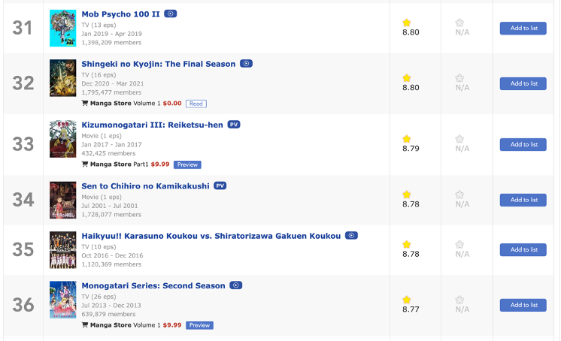
Introduction
With Anime gaining more popularity among the Western community since COVID, I began wondering what are some of the characteristics of the current most popular shows and are there any interesting trends that are showing.
To analyze this information, I have scraped data from MyAnimeList using BeautifulSoup, obtaining the top 1000 anime shows by popularity and by rating (we will primarily focus on popularity). Data is gathered on March 9.
Pandas were then used to clean and generate new helpful calculations. Data is then finally visualized using Tableau and Seaborn.
Code for scraping and cleaning can be found on the same GitHub repository.

Slide 3
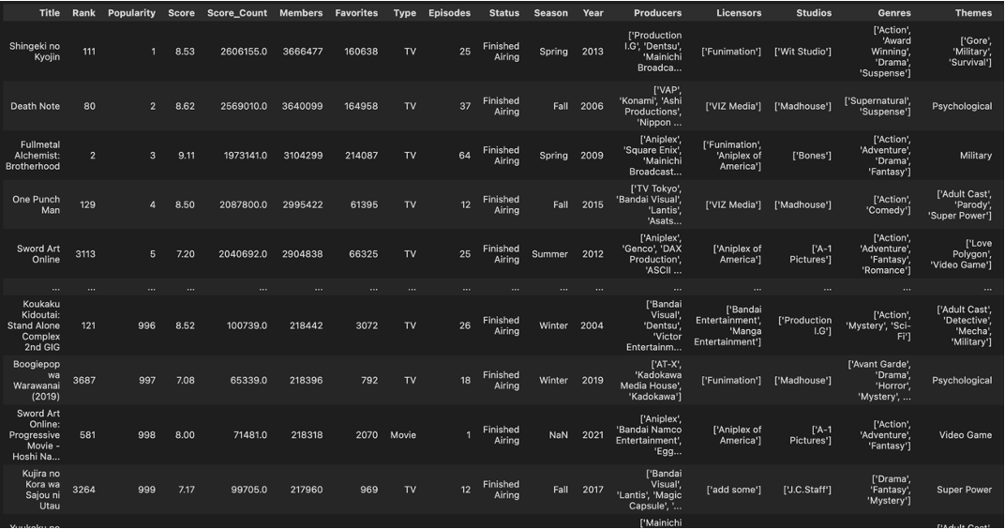
Snapshot of the the raw dataset scraped from MyAnimeList using Python

Slide 4

TLDR Quick Summary
Q: Any shows that were extremely popular but scored very low?
"The Promised Neverland Season 2" and "School Days".
Q: Outstanding genres and studios?
The most popular genres: Action, Comedy, Romance, and Fantasy had lower ratings, while the less popular genres had higher ratings. The least rated genres were "Ecchi" and "Erotica". "Madhouse" and "Bones", followed by "Production I.G." and "Kyoto Animations", have produced the highest number of popular shows with the highest average rating of titles.
Q: Any trends in the popularity of titles by the year?
Interestingly, there seems to be a somewhat inverse relationship between the number of titles and the average rating given by users. When the number of popular titles increased, the average rating for all shows followed a decreasing trend. Similar trends were exhibited vice versa. Although the recent couple of years show a slight dip in the proportion of members who have rated the title, the overall percentage seems to remain constant for the most popular and highest-rated shows.
Q: Do the number of licensors affect the number of members per title?
We noticed that the number of members, the number of titles and licensors were positively correlated. However, the rate of which members were declining was at a similar rate to the number of licensors, while the general pattern matched the number of titles per year.
Q: How has COVID impacted the number of popular shows?
One interesting finding between 2020 and 2021 is the sudden increase in popular shows. Multiple animation studios faced a decline in work productivity due to COVID, causing delays in the production of animation. Despite the difficult times, there has been a spike of popular shows in 2021.

Slide 5
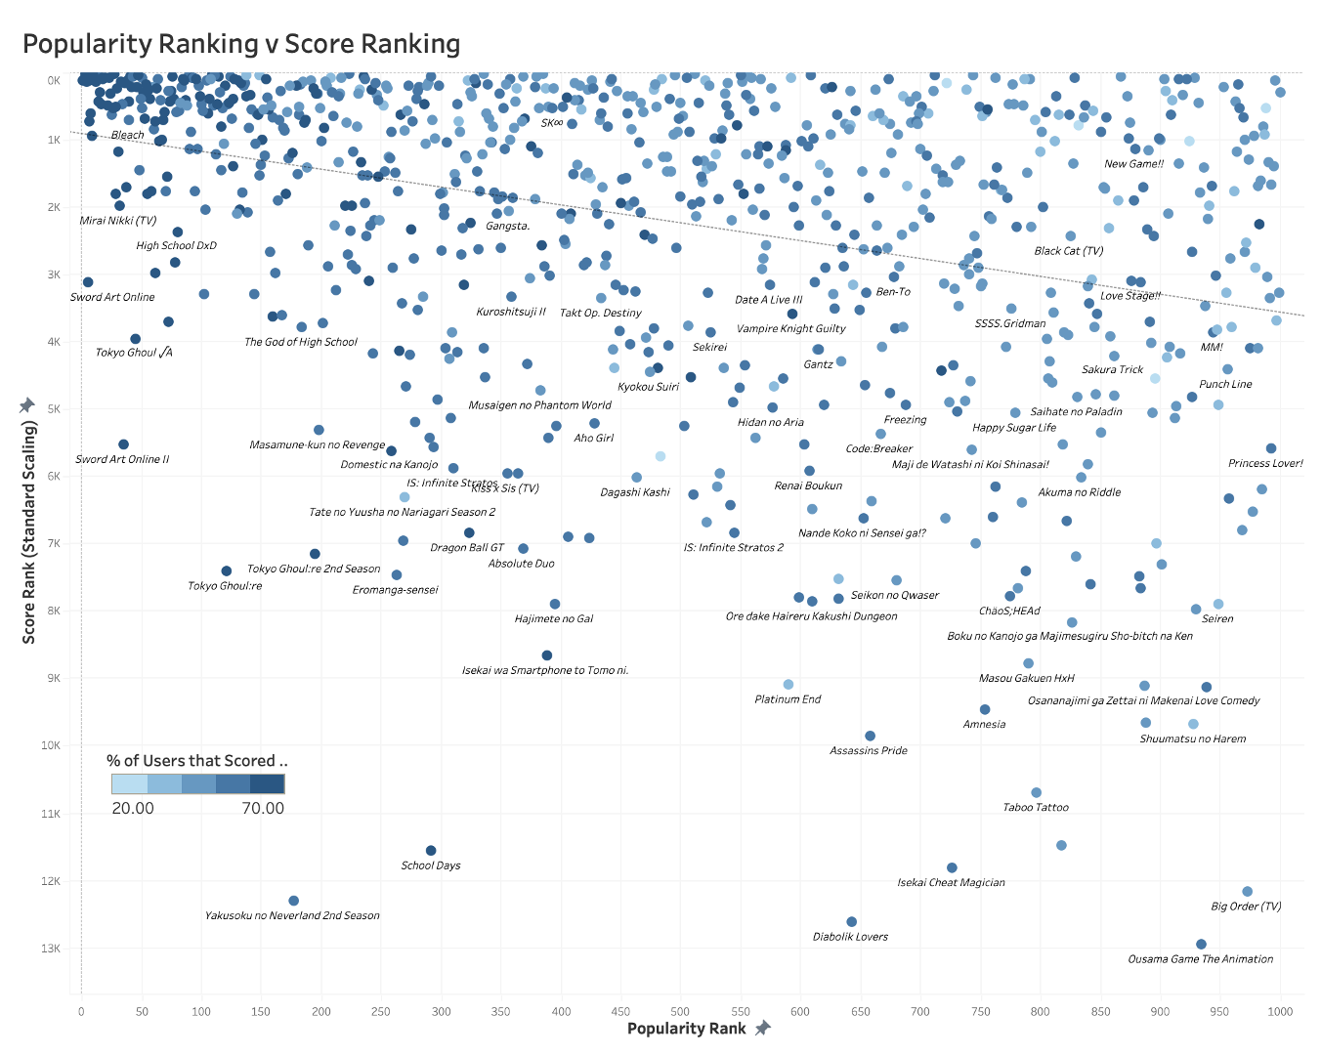
This is a simple scatterplot that shows how the various titles are distributed with the ranking of the score plotted against the popularity.
The shade of the of the point represents the proportion of members that have scored the show. The dotted line represents the line of best fit.
This plot highlights outlying shows: Shows that are extremely popular but scored lowly by the community.

Slide 6
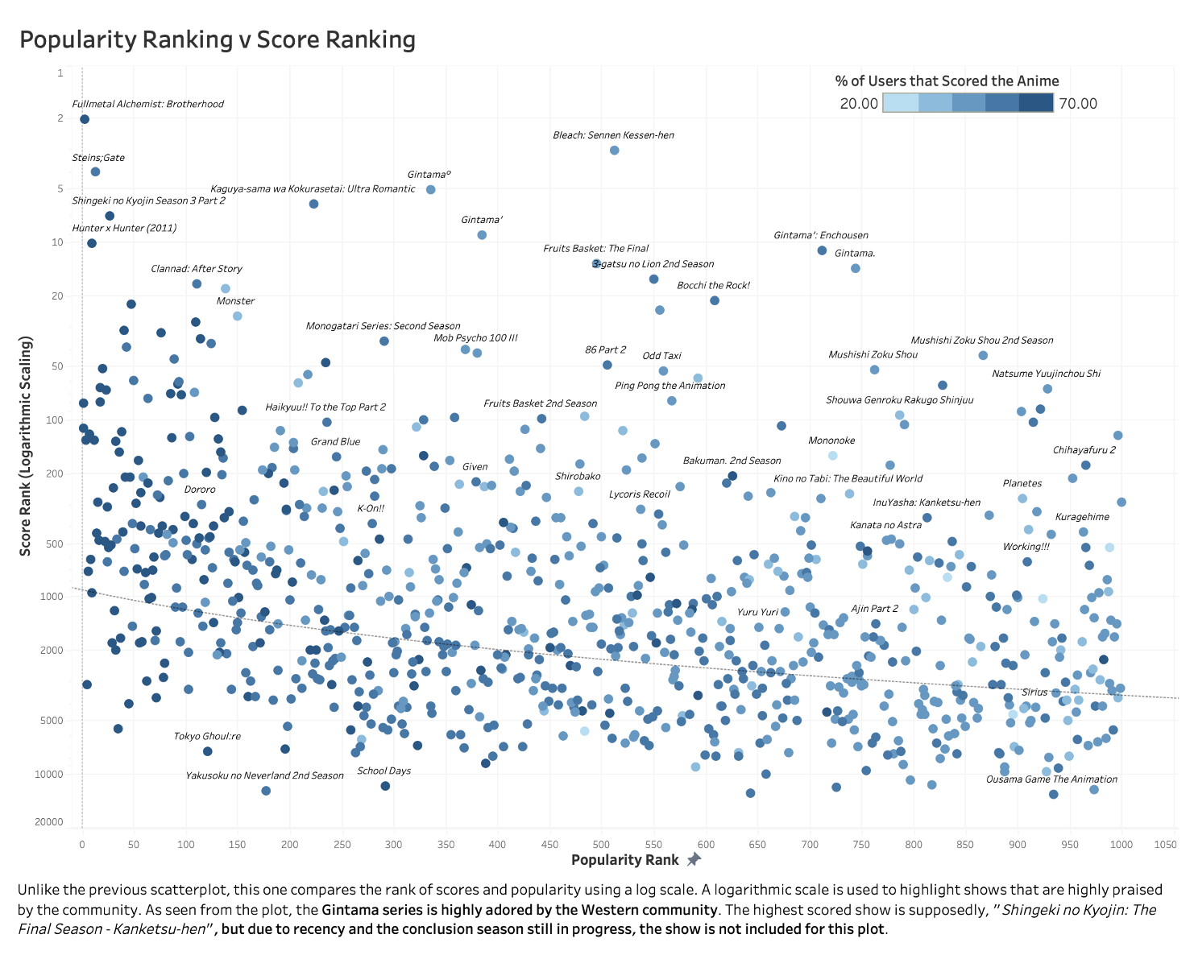
Unlike the previous scatterplot, this one compares the rank of scores and popularity using a log scale. A logarithmic scale is used to highlight shows that are highly praised by the community. As seen from the plot, the Gintama series is highly adored by the Western community. The highest scored show is supposedly, "Shingeki no Kyojin: The Final Season - Kanketsu-hen", but due to recency and the conclusion season still in progress, the show is not included for this plot.

Slide 7
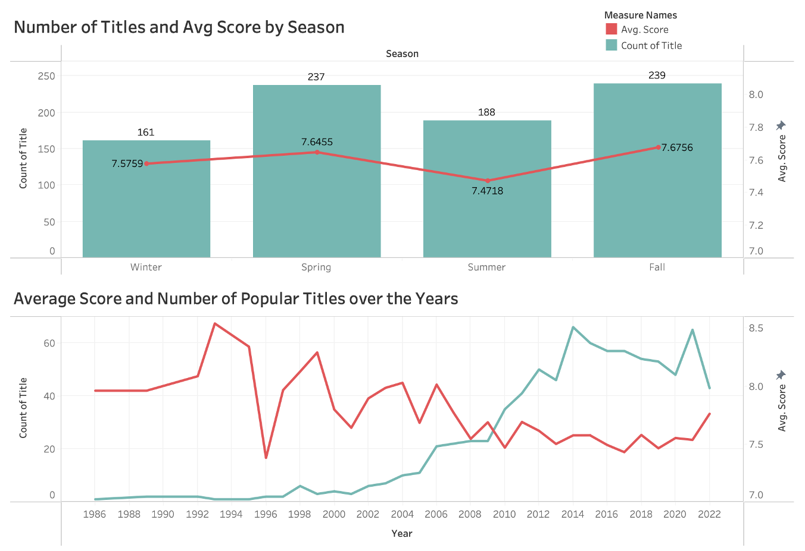
The two plots above compares the number of titles and the average score for the top 1000 anime in popularity. The first plot compares by season the show premiered and the bottom compares by the year of premiere.
From the first plot, we can notice that Spring and Fall seasons have more shows with a higher average rating unlike the two other seasons.
The second plot compares by years. Interestingly, the average rating has been slightly decreasing with a recent rebound while the number of titles have been showing a slight decreasing trend.

Slide 8
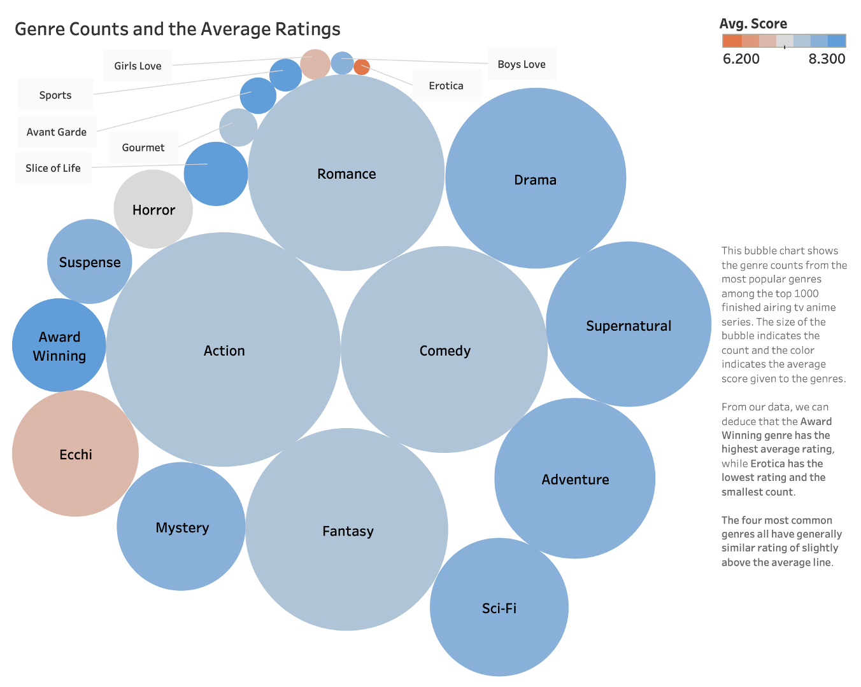

Slide 9
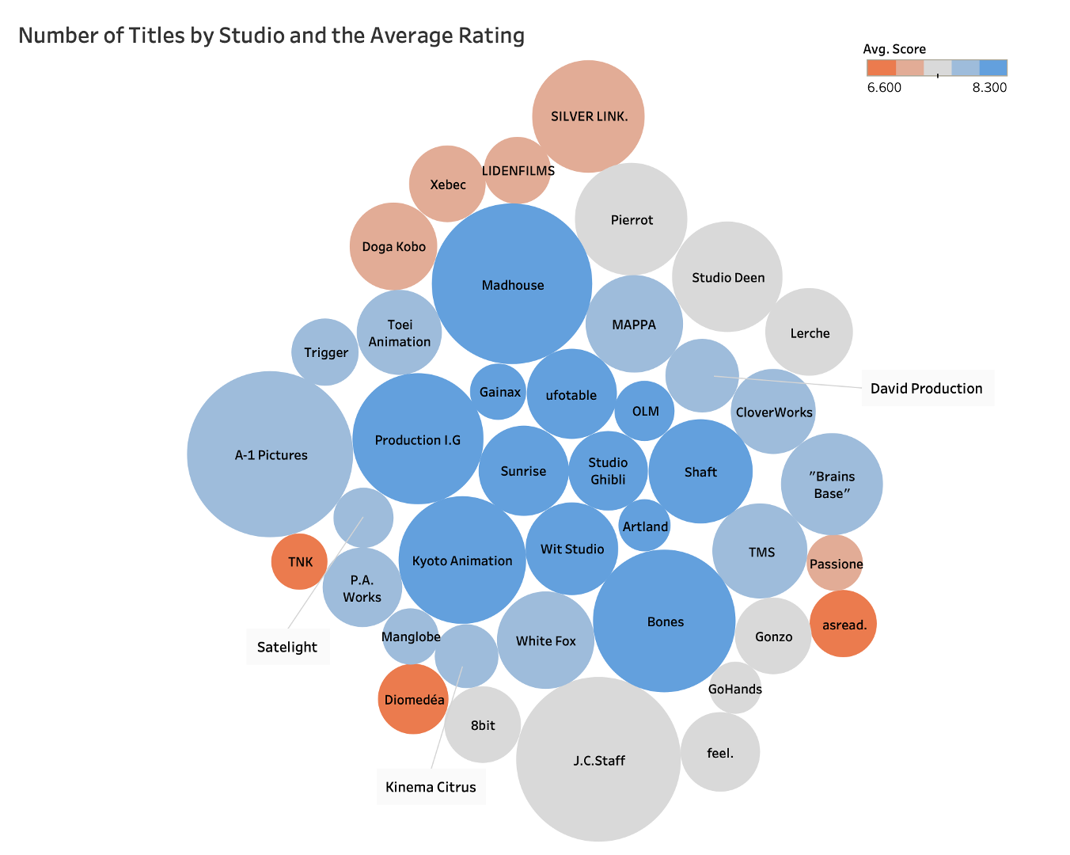

Slide 10
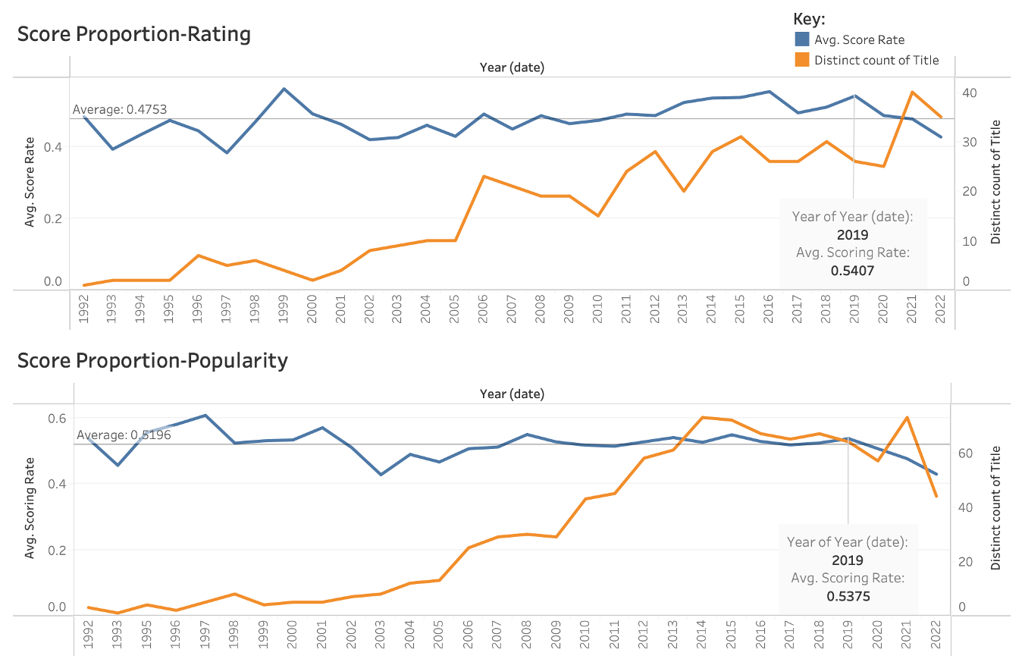
Definition: Score Rate = Proportion of Members that Scored
Summary: There is a trend where recent shows are facing a decreasing scoring rate regardless of the popularity or rating.
There has been an interesting recent trend where the proportion of members who have given scores have been facing a decreasing trend. By looking at the trends for the highest rated shows, there has been a rapid increase of highly rated shows, yet a decreasing number of people who have rated these shows. From the Popularity list, we can see that although there are less popular shows in recent years, there is still a decreasing trend in the scoring rate.
Both plots are showing similar behaviors. Though, this result may have been influenced by recency bias.

Slide 11
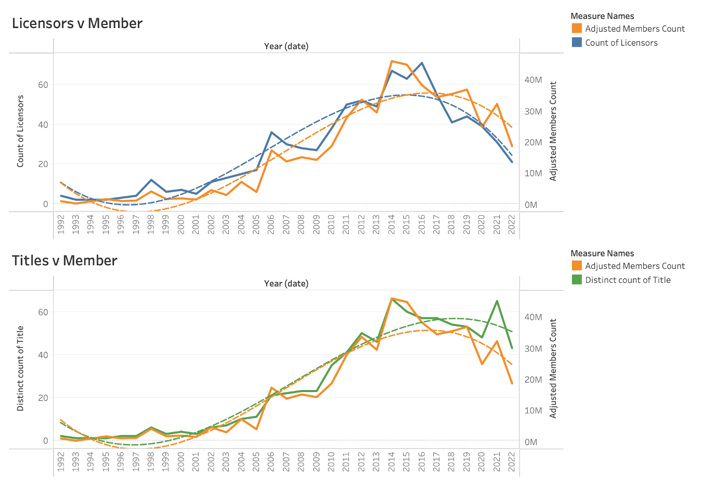
The two plots show the number of Licensors or Titles compared with the number of total members of the top 1000 shows. We can notice that there is an increasing number of shows, licensors, and members as the Years went by. On 2014, the number of members hit a peak, following a decreasing trend ever since. The number of titles and licensors have also been following a similar trend. However, there was a sudden increase of members and titles from 2020 to 2021.
This sudden increase of popular shows may be due to COVID giving the producers and animators extra time to work on the shows, resulting in larger audience size. Interestingly the sudden increase is not reflected in the number of licensors for the titles.

Slide 12
Thank You

